Slide 1
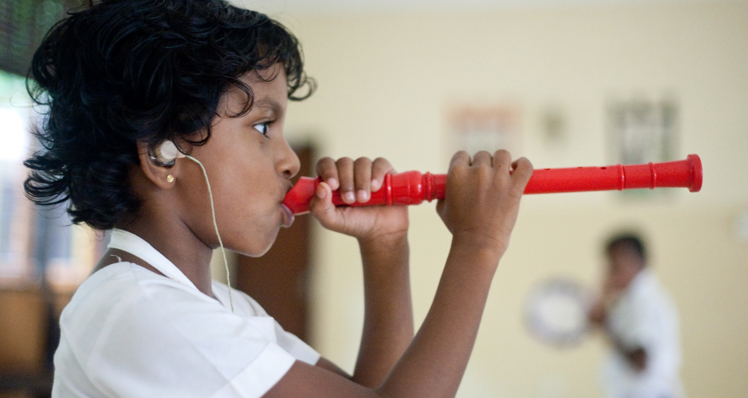
Photo credit: Ingmar Zahorsky, Deaf School Sri Lanka CC BY-NC-ND 2.0
Global Advocacy Promoting Accessibility Dr Irmgarda Kasinskaite-Buddeberg
Knowledge Societies Division, Communication and Information Sector
UNESCO Headquarters in Paris, France
International Conference on ICT for Information Accessibility in Learning 27-28 May 2015 in Riga, Latvia

Slide 2
Major areas of interventions promoting Information Accessibility
Access to Information and Knowledge for Persons with Disabilities
Inclusive legislation, policies and strategies
Building enabling environment
Research and evidence-based data
Content and appropriate tools development
Capacity building
International cooperation mechanisms (UNCRPD, IFAP)
Cooperation
Mobilization
Dissemination
Assessment
Utilization
Creation

Slide 3
24-26 November 2014, New Delhi, India http://www.unesco-ci.org/ict-pwd/

Slide 4
Structure of the international event
International conference
Film Festival
Exhibition
Media
events
Supporting activities
Special website
7 Plenary sessions
Film screenings
Showcase of IT&AT solutions
Online
consultations
National stocktaking event (9-10 September 2014, New Delhi, India)
15 thematic panels
Media event(s)
Capacity building workshop and content development
Other associated events
Materials /content developed
Gala event
Outcome document and follow up activities

Slide 5
Outcomes and follow up
700 participants from around the world representing 80 countries
Three thematic tracks resulted in to the concrete recommendations summarized in the Outcome Document
New Delhi Declaration on Inclusive ICTs for Persons with Disabilities: Making Empowerment a Reality
The Executive Board of UNESCO (58 Member States) examined and endorsed the New Delhi Declaration at its 196th session in April 2015 as well as decided to transmit the document to the 38th session of the General Conference of UNESCO (195 and 9 Associate Members).
Concrete activities:
Organization of regional events (San Jose, fall of 2015)
Development of guidelines on the Inclusion of Students with Disabilities in Open and Distance Learning using Open Solutions (November 2015);
Further elaboration of Inclusive Learning Lab concept.

Slide 6
Thank you for your attention.
Ms Irmgarda Kasinskaite-Buddeberg
i.kasinskaite(at)unesco.org

