Slide 2
ICT for Information
Accessibility in Learning
Guideline Development Workshop
20-21 June, Lisbon

Slide 3
ICT for Information Accessibility in Learning
Follow up of the Accessible Information Provision for Lifelong Learning (i-access) project (2011)
January 2013 – December 2015
Supported under the Lifelong Learning Transversal Programme, Key Activity 3: Information and Communication Technologies
Network of partners

Slide 4
Network Partners
Co-ordinator:
European Agency for Development in Special Needs Education,
Co-Beneficiaries
DAISY,
European Schoolnet,
Global Initiative for Inclusive ICTs,
International Association of Universities,
UNESCO

Slide 5
ICT4IAL Aims
To raise awareness and increase the visibility of the issue of accessible information provision and its relevance for equitable lifelong learning opportunities,

Slide 6
ICT4IAL Aims
Support accessible information provision within organisations through the:
Development of guidelines building on the recommendations for accessible information provision of the i-access project,
Trialing of the guidelines within 3 organisations (EUN, IAU and the Agency),
Evaluating these guidelines and their implementation.

Slide 7
Project objectives
Knowledge exchange and networking
Developing and trialing of practical guidelines
Reflection and evaluation upon implementation
Validation of guidelines
Dissemination and exploitation of results
The Guideline Development Workshop is one of the main activities to support the first two objectives.

Slide 8
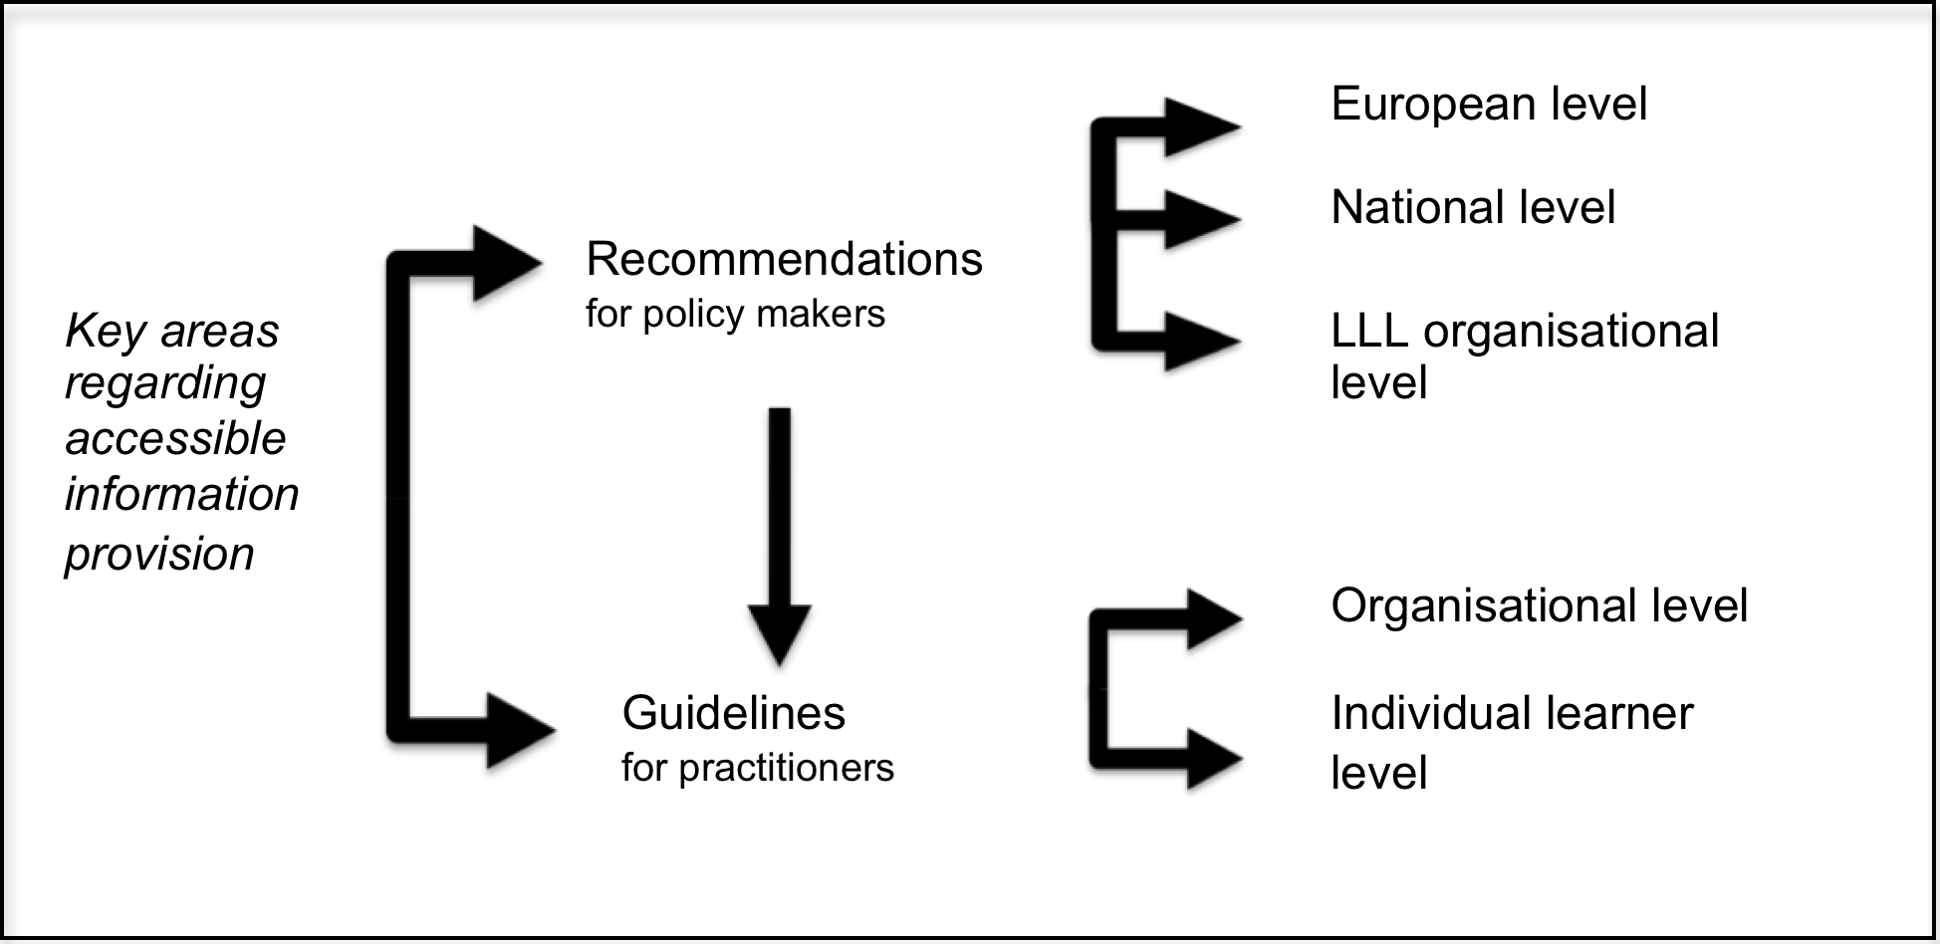
Development of Guidelines
Build on i-access recommendations

Slide 9
i-access Recommendations
Raising awareness about accessible information for lifelong learning as a rights issue.
A multi-stakeholder approach based upon co-operation and information exchange should be taken.
Issues around accessible information provision should be covered in the education of all professionals involved in lifelong learning.
Issues around accessible information provision should be covered in the education of ICT and media professionals.
Accessibility should be a guiding principle for procurement of all goods and services.
Research should be promoted in order to develop an evidence base for future policy design, implementation and evaluation.
Compliance to policy should be systematically monitored.

Slide 10
Development of Guidelines
Build on input of the experts of the Guideline Development Workshop
7 Questions across 4 workshops
Workshop 1: 11.00 – 14.45 (including lunch break)
Workshop 2: 15.00 – 15.45
Workshop 3: 16.00 – 16.45
Workshop 4: 17.00 – 17.45

Slide 11
Workshops
Each workshop will have a moderator and notetaker
Observers will visit workshops to collect key messages
Fixed groups
New groups for workshops 2-4, where each group will rotate to visit the EUN, IAU and the Agency workshop to discuss the accessibility of shared materials
Please pass on your personal notes to the workshop questions to Agency staff

