Slide 1
How European Schoolnet used the Guidelines Roger Blamire, Senior Adviser
Notes:
Marcella

Slide 2
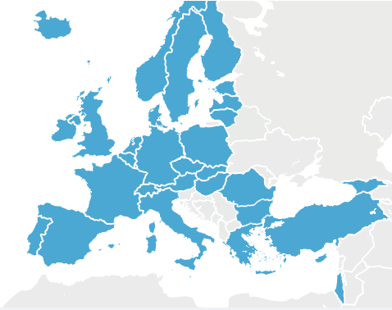
European Schoolnet
Founded in 1997, not for profit, based in Brussels, 65 staff
Governed by 25 ministries of education
Aim: to bring innovation in teaching and learning to ministries of education, schools, teachers, researchers and industry

Slide 3
Remit
To mainstream teaching and learning in schools aligned with 21st century skills, standards and expectations for all students
To act as a think tank and training provider to help ministries and European stakeholders develop policies to support evidence-based educational reform at European level
Peer exchanges
Technology-supported innovation in teaching and learning
Surveys and reports

Slide 4
100+ recent projects
Innovation
School partnerships
1:1 pedagogy
Future Classroom Lab
Key competences
STEM
Digital skills, e-safety
Professional development
Academy
Studies
Survey of Schools: ICT and Education
Inclusion
Notes:
100 projects since 2011
eTwinning 45% of all EU schools
FCL : Interact, Exchange, Develop, Investigate, Present

Slide 5
Implementation of the guidelines
Process
Awareness – action/support – monitor – sanction
Internal
65 staff in Brussels office
External
Ministries of education in 30 countries
350,000 schools in Europe
Events and workshops
Notes:
Important to introduce the topic to the staff, give room for questions e.g. which font size is big enough?
During the session, colleagues reported that teachers with students with special needs participate in EUN projects

Slide 6
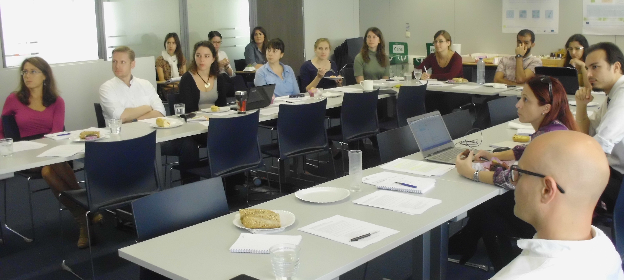
Internal implementation
E.g. lunch session for EUN staff, October 2014
Presentation, illustration, discussion, engagement
Notes:
Important to introduce the topic to the staff, give room for questions e.g. which font size is big enough?
During the session, colleagues reported that teachers with students with special needs participate in EUN projects

Slide 7
Implementation of the guidelines
Next steps recommended by staff:
Checking accessibility of templates
Embrace accessibility as a key priority by management
Adopt a general policy to involve key players like website designers
Add a reference to the electronic version of all print documents
Include costs for responsive web in proposals

Slide 8
Implementation of the guidelines
Adapted EUN guidelines on text and web accessibility
Promotion and dissemination across EUN projects
Preparation of exemplar documents
Awareness raising and advocacy with ministries of education
European Schoolnet Academy MOOC course ‘Creative use of tablets’: provision of video scripts for the first time
Very well received by course participants
Notes:
- Preparation of accessible documents (to test guidelines) was also a professional development exercise for the colleagues involved
Scripts for MOOC course videos were very well received by course participants, also as part of the notion of personalized learning discussed as one topic in the course: so scripts improve accessibility & personalised learning experience
Almost 1000 people finished the MOOC course

Slide 9
External implementation
Policymaker: 30 ministries of education
Annual conference
Briefing notes
Practitioner: 350,000 schools in Europe
Projects: eTwinning, Scientix, ENABLE, tablet computers …
Face-to-face events and workshops: Future Classroom Lab
Newsletters, Twitter, FaceBook group (SENnet), …
Notes:
Important to introduce the topic to the staff, give room for questions e.g. which font size is big enough?
During the session, colleagues reported that teachers with students with special needs participate in EUN projects

Slide 10
Contact Us
www.ict4ial.eu
This project has been funded with support from the European Union. This presentation reflects the views only of the author, and the Commission cannot be held responsible for any use which may be made of the information contained therein.
European Agency for Special Needs and Inclusive Education
DAISY Consortium
European Schoolnet
Global Initiative of Inclusive ICTs
International Association of Universities
United Nations Educational, Scientific and Cultural Organization
Notes:
http://www.ict4ial.eu
This project has been funded with support from the European Commission. This project reflects the views only of the author, and the Commission cannot be held responsible for any use which may be made of the information contained therein.
European Agency for Special Needs and Inclusive Education http://www.european-agency.org
DAISY Consortium http://www.daisy.org
European Schoolnet http://www.eun.org
Global Initiative of Inclusive ICTs http://www.g3ict.com
International Association of Universities http://www.iau-aiu.net
United Nations Educational, Scientific and Cultural Organization http://www.unesco.org
Insert name of Presenter
Insert contact details of Presenter

