Slide 1
Information Accesibility for learning December 11, 2015
University Policy on Open Access to scientific literature
Chiara Cenderelli
University Library Services-Open Access referent
chiara.cenderelli@polimi.it

Slide 2
Open Access (OA): what is it?
“Open-access (OA) literature is digital, online, free of charge, and free of most copyright and licensing restrictions.”
Peter Suber
Notes:
OA is a movement, born within the academic world, that promotes free access to results from scientific research and favors the sharing and growth of scientific knowledge.
OA refers to online research outputs that are free of all restrictions on access (e.g., access tolls) and free of many restrictions on use (e.g. certain copyright and license restrictions). Open access can be applied to all forms of published research output, including academic journal articles, conference papers, theses, book chapters and monographs.
The aim is to ensure maximum visibility and use of documents, via open access, starting with the basic idea that the results of publicly funded research must be available to everyone.

Slide 3
Open Access (OA): why?
widen dissemination (advantages for researchers)
maximum visibility (international window for the production of an institution)
sharing and growth of scientific knowledge to accelerate research and enrich education (advantages for the scientific community)
results of publicly funded research available to everyone to enhance return on taxpayer investment in research
reduce the overall costs of scholarly publishing
Notes:
There are many reasons that are behind

Slide 4
Open Access: How? (1)
There are two complementary strategies to achieve open access:
1. Publish in an Open Access journal / GOLD open access
Directory of Open Access Journals (DOAJ)
is an online directory that indexes and provides access to high quality, open access, peer-reviewed journals.
10,831 Journals
6,684 searchable at Article level
136 Countries
2,060,348 Articles

Slide 5
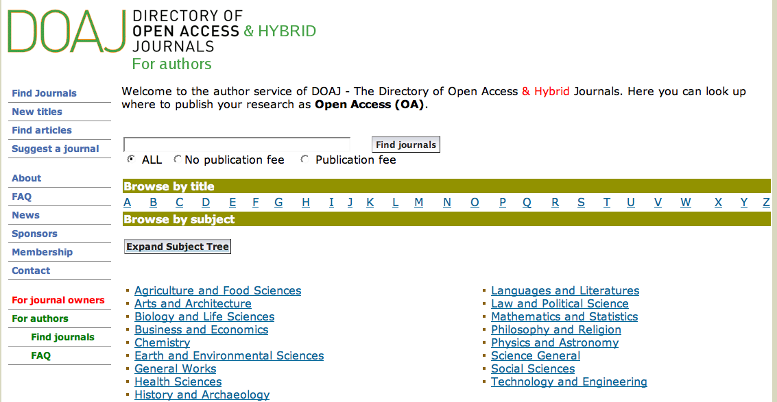

Slide 6
Open Access: How? (2)
2. Publish in a conventional journal and deposit a copy of the published paper in an Open Access repositories - institutional or disciplinary / GREEN open access
(If the journal has a self-archiving policy)

Slide 7
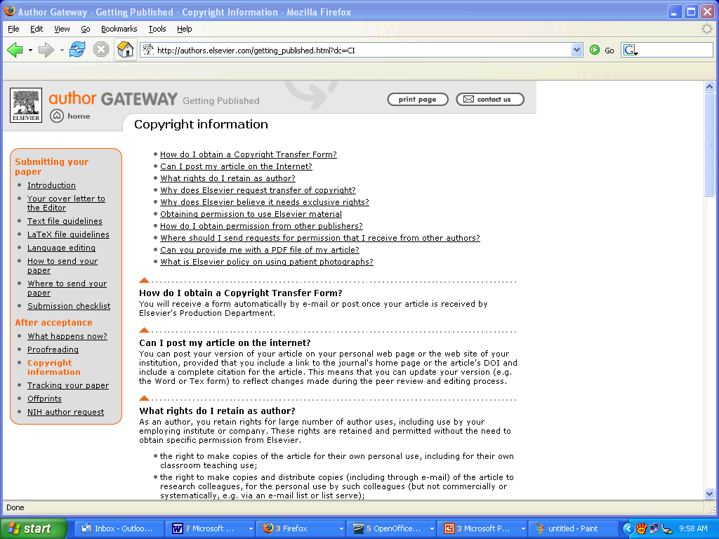

Slide 8
External Input to OA (1)
European Commission
Recommendations
at Member State level (encouragement of national initiatives; policy coordination)
Funding policies
at European level (Framework Programmes)
Open Access Pilot in FP7 (2007-2013)
Horizon 2020 (2014-2020)
Notes:
Since many years, the European Union (EU) strives to improve access to scientific information and to boost the benefits of public investment in the research funded thought both recommendations and funding programs

Slide 9
Recommendation for policy coordination
"Research funding agencies... should [e]stablish a European policy mandating published articles arising from EC-funded research to be available after a given time period in open access archives...“
Notes:
EC asks the academic institutions in member states to draw up and implement policies for the diffusion of scientific publications and open access.

Slide 10
New Framework Programme Horizon 2020 (2014-2020)
Open access as a principle in Horizon 2020 now has its legal basis in the Framework Program itself and in its Rules for Participation
“each beneficiary must ensure open access to all peer-reviewed scientific publications relating to its results”

Slide 11
External Input to OA (2)
Italian Law 112/2013
Art. 4: «The public bodies, responsible for the provision or management of the funding of scientific research, take, in their autonomy, the necessary measures for the promotion of Open Access to results of research funded for a share equal to or greater than 50% of public funds…
Notes:
Nationally, in october 2013, the Decree Law dated 8th August 2013, was finally approved by Parliament on 3rd October 2013 and converted with amendments by Law no. 112 dated 7th October 2013.

Slide 12
what are we doing?
Politecnico’s Statute, art 4
«Polytechnic encourages full and open access to knowledge, promoting the free movement and the wider dissemination, also in digital format, of educational, cultural and organizational “
Messina Declaration (2004/w014)
74 Italian universities "... declare to adhere to the Berlin Declaration on Open Access to Knowledge in the Sciences and Humanities in support of open access to scientific literature, with the hope that this gesture will constitute an initial, important contribute
Notes:
What we did and what we are doing in our university
The Politecnico di Milano promotes open access to scientific literature in compliance with what is established by its own statute and as a signatory of the Messina Declaration. The declaration was signed by 74 Italian universities, including the Politecnico di Milano and Politecnico has renewed his adhesion in the last year.
To do this, the Politecnico di Milano has an Open Access policy that applies the EU Commission Recommendations and national law 7 October 2013, n. 112.

Slide 13
University Policy on Open Access to Scientific Literature
July 14, 2014: approval of the policy in Academic Senate
October 1, 2014: entry into force of the Policy
Notes:
The university policy, that has been active since 1st October 2014, states that professors, researchers, and collaborators of the Politecnico di Milano feed the university's institutional open access archive by self-archiving their scientific products in it.

Slide 14
Key points of the policy open access (1)
self archive the permitted editorial version
«The authors must feed the Politecnico di Milano research product catalogue by entering metadata, the digital copy of the contribution and other required information, that will automatically go into the institutional archive....
accord a free, irrevocable, universal, nonexclusive license to publish in OA
“On filing his work, the author issues the university with a free, irrevocable, universal, nonexclusive license to publish his contribution in open access in the institutional archive, notwithstanding the cases of incompatibility with other rights (publishers' copyright policies)…in the case of publicly-funded works.

Slide 15
Key points of the policy open access (2)
applies the time prescribed by national law
If the author intends to transfer the exploitation rights for the work to third parties, the authors should do this with publishers who permit self-archiving, even if after an embargo period that does not exceed 18 months if they are journal articles
make exceptions to policy
If the author waives publication explicitly and the motivations come under the ones allowed in the event of public funding, the contribution will remain "closed access"

Slide 16
Institutional repository (1)
IRIS-RE.PUBLIC@POLIMI
the archive:
responds to best practice and international technical standards for open access
takes into consideration CRUI Libraries Commission Open Access Group guidelines
is interoperable with the Research Register and the MIUR databanks
is based on open-source technologies.
Notes:
IRIS is an IT platform that makes it easy to collect and manage data on research activities and outputs within an organization.
takes into consideration the and is interoperable with the Research Register and the MIUR databanks.

Slide 17
Institutional repository (2)
The module OA complies with the requirements of the Ministry of Education
Law no. 4/2004 containing the "Provisions to support the access of disabled people to computing ‘
And is accordant with the requirements of the European Commission for Open Access and the requirements in the Agreements of Horizon2020

Slide 18
Agreement H2020
Step1 : beneficiaries must deposit a machine-readable electronic copy of the published version or final peer-reviewed manuscript accepted for publication in a repository for scientific publications”… “the publications must be in a format that can be used and understood by a computer. They must be stored using text file formats which are either standardized or otherwise publicly known so that anyone can develop new tools for working with these documents.”

Slide 19
Work Group on open access
The work group is responsible for applying this policy.
In particular it:
takes care of and supervises archiving and publication of contributions and relative metadata in the institutional archive
provides technical and legal aid to the authors
monitors application of the policy
organizes regular training initiatives on open access for the authors
organizes public events, such as conferences and seminars, increasing awareness of the open access principle.
openaccess@polimi.it
Notes:
The university policy on Open Access to scientific literature set up a Work Group on open access.
The group is heterogeneous and consists of members of library services, search of the area and of the ICT (administrative staff), and two professors, one for each of the two areas of scientific credentials University. The group has appointed technical skills of storage, intellectual property rights and management skills.

Slide 20
Promotion of open science
Web pages with information materials and technical
(FAQ, materials and useful references for publication and/or auto-self-archiving in open access, ecc.
http://www.biblio.polimi.it/servizi/pubblicare-in-oa)
Direct contact with teachers
Meetings in the Departments to clarify doubts and suggestions
Organization and participation in public events, such as conferences and seminars, to promote open science
Notes:
We did a great job last year to promote open science, to disseminate issues and opportunities.
We think it's important to spread the culture of sharing and access to information, especially for those organizations that the Information and culture base their daily business, whether through research or teaching that refers to it as an educational tool.
So as you need a great deal of education to those who are the problems of accessibility to content for people with disabilities because the rights of access to information should be everyone.

Slide 21
Conclusion
The mission is for all of us raise awareness
Thank you
The real advantage of Open Access is Access. The advantage of Access is Usage and Impact (of which citations are one indicator).
Stevan Harnad
Notes:
The digital offers new opportunities for all of us, not just for people with visual impairment. To fully exploit this potential, however, is essential to the cooperation of everyone, both creators (authors), both of whom spreads (publishers) in one direction, the accessibility of content, now more and more stringent and binding.

